Slide 1
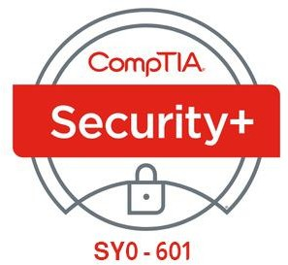

10- Implementing Network Security Appliances
Ehab Fahmi
Senior Cyber Security Consultant - Instructor

Slide 2
Outlines
10.1- Implement Firewalls and Proxy Servers
10.2- Implement Network Security Monitoring
10.3- Summarize the Use of SIEM

Slide 3
PACKET FILTERING FIREWALLS
Access Control Lists (ACLs)
A packet filtering firewall is configured by specifying a group of rules, called an access control list (ACL).
Each rule defines a specific type of data packet and the appropriate action to take when a packet matches the rule.
An action can be either to deny (block or drop the packet, and optionally log an event) or to
accept (let the packet pass through the firewall).
A packet filtering firewall can inspect the headers of IP packets.
This means that rules can be based on the information found in those headers:
IP filtering—accepting or denying traffic on the basis of its source and/or destination IP address.
Protocol ID/type—(TCP, UDP, ICMP, routing protocols, and so on).
Port filtering/security—accepting or denying a packet on the basis of source and destination port numbers (TCP or UDP application type).

Slide 4
PACKET FILTERING FIREWALLS (cont.)
There may be additional functionality in some products, such as the ability to block some types of ICMP (ping) traffic but not others, or the ability to filter by hardware (MAC) address.
Another distinction that can be made is whether the firewall can control only inbound traffic or both inbound and outbound traffic.
This is also often referred to as ingress and egress traffic or filtering.
Controlling outbound traffic is useful because it can block applications that have not been authorized to run on the network and defeat malware, such as backdoors.
Ingress and egress traffic is filtered using separate ACLs.

Slide 5
PACKET FILTERING FIREWALLS (cont.)
Stateless Operation
A basic packet filtering firewall is stateless.
This means that it does not preserve information about network sessions.
Each packet is analyzed independently, with no record of previously processed packets.
This type of filtering requires the least processing effort, but it can be vulnerable to attacks that are spread over a sequence of packets.
A stateless firewall can also introduce problems in traffic flow, especially when some sort of load balancing is being used or when clients or servers need to use dynamically assigned ports.

Slide 6
STATEFUL INSPECTION FIREWALLS
A stateful inspection firewall addresses these problems by tracking information about the session established between two hosts, or blocking malicious attempts to start a bogus session.
The vast majority of firewalls now incorporate some level of stateful inspection capability.
Session data is stored in a state table.
When a packet arrives, the firewall checks it to confirm whether it belongs to an
existing connection.
If it does not, it applies the ordinary packet filtering rules to determine whether to allow it.

Slide 7
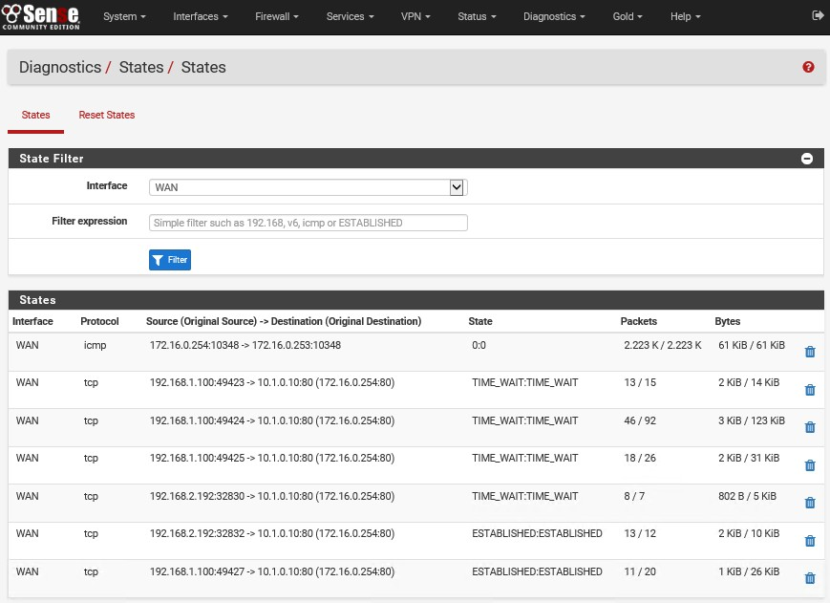
STATEFUL INSPECTION FIREWALLS (cont.)

Slide 8
STATEFUL INSPECTION FIREWALLS (cont.)
Stateful inspection can occur at two layers: transport and application.
Transport Layer (OSI Layer 4)
At the transport layer, the firewall examines the TCP three-way handshake to distinguish new from established connections.
A legitimate TCP connection should follow a SYN > SYN/ACK > ACK sequence to establish a session, which is then tracked using sequence numbers.
Deviations from this, such as SYN without ACK or sequence number anomalies, can be dropped as malicious flooding or session hijacking attempts.
The firewall can be configured to respond to such attacks by blocking source IP addresses and throttling sessions.
It can also track UDP connections, though this is harder as UDP is a connectionless protocol.
It is also likely to be able to detect IP header and ICMP anomalies.

Slide 9
STATEFUL INSPECTION FIREWALLS (cont.)
Application Layer (OSI Layer 7)
An application-aware firewall can inspect the contents of packets at the application layer.
One key feature is to verify the application protocol matches the port; to verify that malware isn't sending raw TCP data over port 80 just because port 80 is open, for instance.
As another example, a web application firewall could analyze the HTTP headers and the HTML code present in HTTP packets to try to identify code that matches a pattern in its threat database.
Application-aware firewalls have many different names, including application layer gateway, stateful multilayer inspection, or deep packet inspection.
Application aware devices have to be configured with separate filters for each type of traffic (HTTP and HTTPS, SMTP/POP/IMAP, FTP, and so on).
The firewall cannot examine encrypted data packets, unless configured with an SSL/TLS
inspector.

Slide 10
FIREWALL IMPLEMENTATION
Firewall Appliances
An appliance firewall is a stand-alone hardware firewall deployed to monitor traffic passing into and out of a network zone.
A firewall appliance can be deployed in two ways:
Routed (layer 3)—the firewall performs forwarding between subnets, Each interface on the firewall connects to a different subnet and represents a different security zone.
Bridged (layer 2)—the firewall inspects traffic passing between two nodes, such as a router and a switch, This is also referred to as transparent mode, The firewall does not have an IP interface (except for configuration management), It bridges the Ethernet interfaces between the two nodes, Despite performing forwarding at layer 2, the firewall can still inspect and filter traffic on the basis of the full range of packet headers, The typical use case for a transparent firewall is to deploy it without having to reconfigure subnets and reassign IP addresses on other devices.

Slide 11
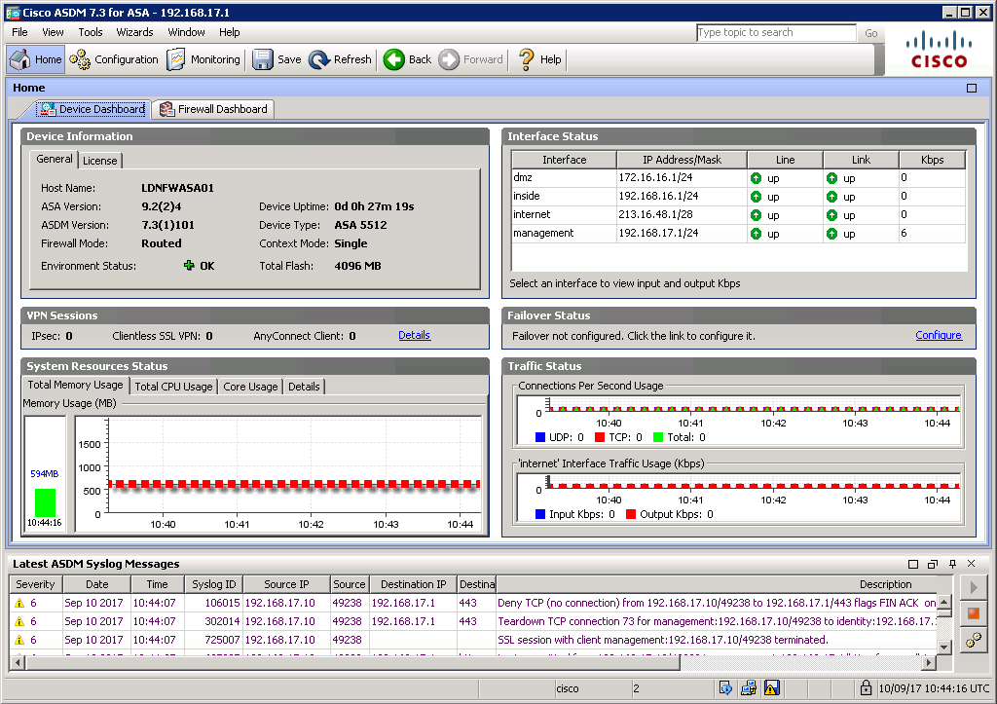
FIREWALL IMPLEMENTATION (cont.)

Slide 12
FIREWALL IMPLEMENTATION (cont.)
A router firewall or firewall router appliance implements filtering functionality as part of the router firmware.
The difference is that a router appliance is primarily designed for routing, with firewall as a secondary feature.
SOHO Internet router/modems come with a firewall built-in, for example.

Slide 13
VIRTUAL FIREWALLS
Virtual firewalls are usually deployed within data centers and cloud services.
A virtual firewall can be implemented in three different ways:
Hypervisor-based—this means that filtering functionality is built into the hypervisor or cloud provisioning tool, You can use the cloud's web app or application programming interface (API) to write access control lists (ACLs) for traffic arriving or leaving a virtual host or virtual network.
Virtual appliance—this refers to deploying a vendor firewall appliance instance using
virtualization, in the same way you might deploy a Windows or Linux guest OS..
Multiple context—this refers to multiple virtual firewall instances running on a hardware firewall appliance, Each context has a separate interface and can perform a distinct filtering role.

